Slide 1

MVVM and Data Binding
Let’s make everything loosely coupled.
Mark Erwin Villariña, Senior Mobile Developer @ ERNI

Slide 2
MVVM
Model-View-ViewModel

Slide 3
MVVM
Model-View-ViewModel
The Model-View-ViewModel (MVVM) pattern helps you to cleanly separate the business and presentation logic of your application from its user interface (UI).

Slide 4
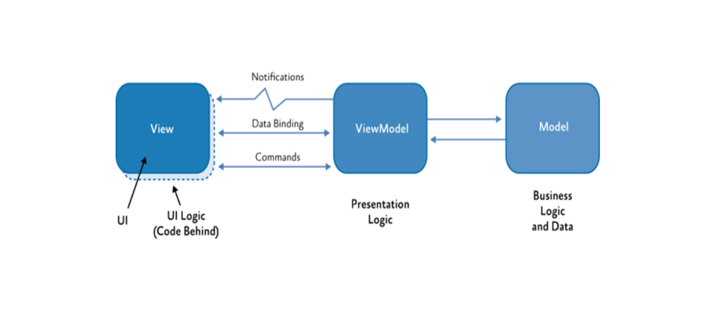

MVVM
Model-View-ViewModel

Slide 5
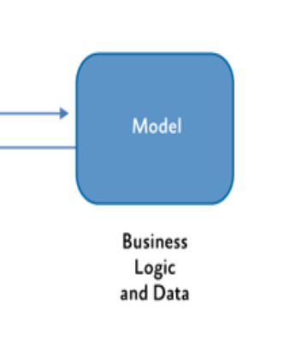
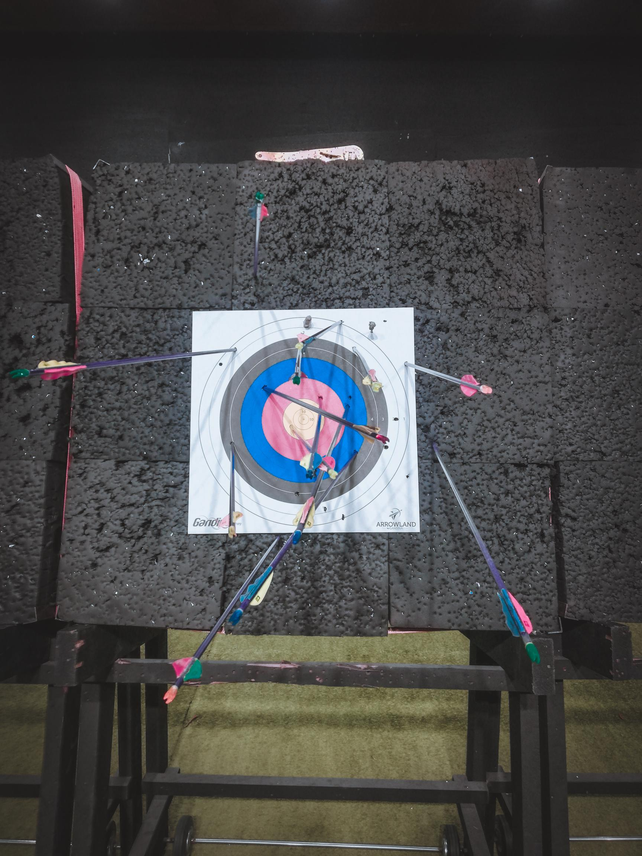
Model
Model-View-ViewModel
The model in the MVVM pattern encapsulates business logic and data.
The model represents the client-side domain model for the application.
It can define data structures based on the application's data model and any supporting business and validation logic.
The model implements the facilities that make it easy to bind to the view.

Slide 6
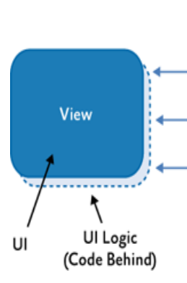
View
Model-View-ViewModel
The view's responsibility is to define the structure and appearance of what the user sees on the screen.
The code-behind of a view contains only a constructor that calls the InitializeComponent method.
The code-behind may contain UI logic code that implements visual behavior that is difficult or inefficient to express in Extensible Application Markup Language (XAML)

Slide 7
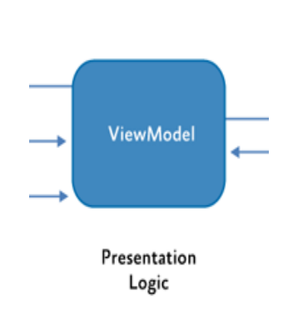
ViewModel
Model-View-ViewModel
The view model in the MVVM pattern encapsulates the presentation logic and data for the view.
It has no direct reference to the view or any knowledge about the view's specific implementation or type.
The view model implements properties and commands to which the view can data bind and notifies the view of any state changes through change notification events.

Slide 8
Prism
MVVM Framework
Prism is a framework for building loosely coupled, maintainable, and testable XAML applications in WPF, and Xamarin Forms.
Separate releases are available for each platform and those will be developed on independent timelines.
Prism provides an implementation of a collection of design patterns that are helpful in writing well-structured and maintainable XAML applications, including MVVM, dependency injection, commands, EventAggregator, and others.

Slide 9
Navigation Basic
Parameters
Creating Parameters
Getting Parameters – OnNavigatingTo and OnNavigatedFrom
Get the NavigationMode

Slide 10
Lifecycle
public class ContactPageViewModel : INavigationAware
{
public void OnNavigatedTo(INavigationParameters parameters)
{
}
public void OnNavigatedFrom(INavigationParameters parameters)
{
}
}

Slide 11
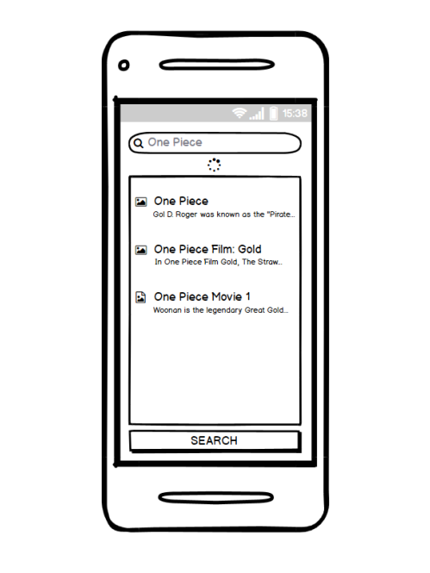
Analyzing our XAML
First Page
Topics Covered:
Buid interface
Show Entry
Show List
Clone code:
https://github.com/mindofai/XamarinForBeginners/tree/MyAnimeList-Before

Slide 12
Commands
The Prism DelegateCommand class encapsulates two delegates that each reference a method implemented within your ViewModel class.
It implements the ICommand interface's Execute and CanExecute methods by invoking these delegates.

Slide 13
Commands
public class ArticleViewModel
{
public DelegateCommand SubmitCommand { get; private set; }
public ArticleViewModel()
{
SubmitCommand = new DelegateCommand<object>(Submit, CanSubmit);
}
void Submit(object parameter)
{
//implement logic
}
bool CanSubmit(object parameter)
{
return true;
}
}

Slide 14
Converters
Converters use when we wanted to change a control value based on a property value in the model., it uses a different class to do the validation.
When creating the new class, implement the interface IValueConverter by adding two methods:
Convert: To convert a model value to a new value to be shown.
ConvertBack: Could be use when the value will be saved in a different format. For example you have a DateTime, and you want it to be saved with a different format, you can use this method to add the conversion.

Slide 15
Converters
public class NullToVisibilityConverter : IValueConverter
{
public object Convert(object value, Type targetType, object parameter, CultureInfo culture)
{
return !string.IsNullOrEmpty($"{value}");
}
public object ConvertBack(object value, Type targetType, object parameter, CultureInfo culture)
{
throw new NotImplementedException();
}
}

Slide 16
Analyzing our XAML
Secibnd Page
Topics Covered:
Buid interface
Show Entry
Show List
Clone code:
https://github.com/mindofai/XamarinForBeginners/tree/MyAnimeList-Before

Slide 17
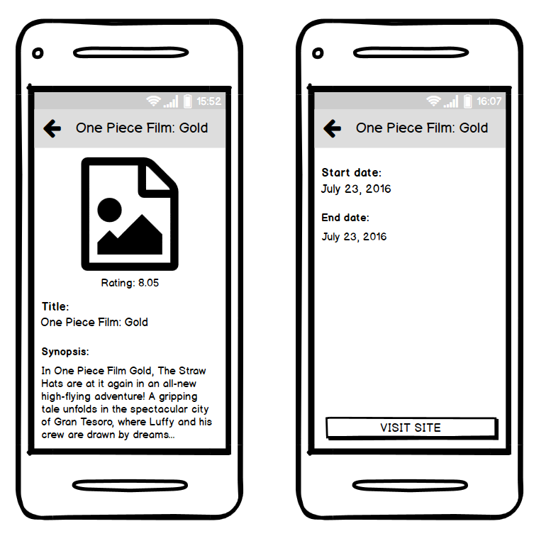
Analyzing our XAML
Second Page

Slide 18
Thank you!
Shoot your Questions!
Mark Erwin Villariña, Senior Mobile Developer @ ERNI

